Slide 1
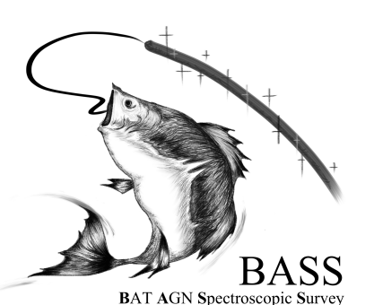

Probing the Environments of Local AGN with Swift-BAT
Meredith Powell
X-ray Universe 2017
Collaborators: Nico Cappelluti, Meg Urry, Mike Koss, Andrew Hearin
Notes:
Hello, I’m Merry Powell and I’m a PhD student at Yale working with Meg Urry&Nico cappelluti. Today I’ll be talking about probing the cosmic environments of local AGN, using swift-bat for a sample nearly unbiased towards obscuration.

Slide 2
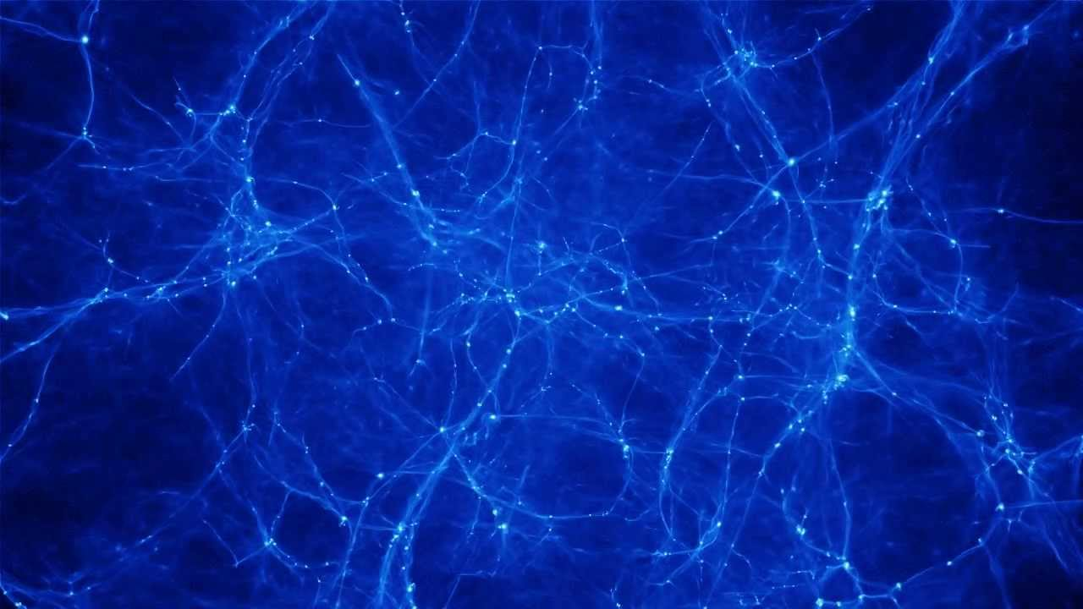
AGN Clustering
Notes:
One way of constraining large-scale galaxy environments is with clustering studies. Galaxies form inside dark matter halos, which have gravitationally collapsed at the peaks of the dark matter distribution, and so how they’re distributed in space only depends on (1) how the individual dark matter halos cluster (which just depends on cosmology) ) and (2) how they occupy their individual halos (which depends on their formation & evolution). So the AGN clustering, as an event of galaxy evolution, can constrain the environments of growing supermassive black holes.

Slide 3
AGN Clustering
Typical environment that AGN reside – constrains:
Trigger mechanisms (ex-situ vs. in-situ)
Evolutionary scenarios of BH growth
Host galaxy properties
Notes:
In doing so, it can constrain AGN trigger mechanisms, evolutionary scenarios if selection effects are properly taken into account, and lastly can tell you about the host galaxy (since galaxy clustering has been extensively studied as functions of various galaxy properties)

Slide 4
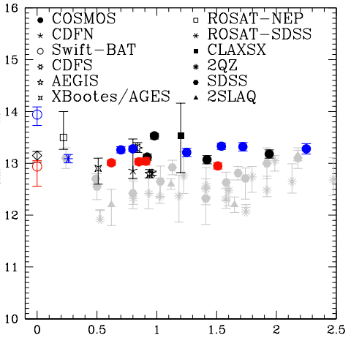
Previous Measurements
(soft) X-ray AGN: M_{h} ~ 10¹³ M
Optical AGN: M_{h}~ 10^{12.5} M (Merger Triggered?)
But major part of SMBH accretion is missed!
Log M_{h} (Mh⁻¹)
z
Notes:
Previous measurements have estimated the average dark matter halo mass that their AGN sample resides, shown by this plot here, where the gray points used optical quasar samples in large volume surveys, and the solid points used x-ray AGN. What they found is that x-ray AGN live in larger DM halos than optical quasars, despite the fact that quasars have higher luminosities, and that halo masses are constant across redshift.
The red and blue points correspond to obscured and unobscured AGN, respectively, and it’s a current controversy whether the two types of AGN occupy the same environments (consistent with the unified model) or different ones. However, the samples all have various selection probing different volumes and AGN luminosities. And soft x-ray detection and optical detection miss a large fraction of obscured AGN, especially at the lower redshifts.

Slide 5
Previous Measurements
(soft) X-ray AGN: M_{h} ~ 10¹³ M
Optical AGN: M_{h}~ 10^{12.5} M (Merger Triggered?)
But major part of SMBH accretion is missed!
Log M_{h} (Mh⁻¹)
Cappelluti et al. 2010
z
Notes:
A remedy of this is using hard X-ray detection for a benchmark z=0 measurement
The data points here correspond to Cappelluti et al. 2010, which used the 22-month Swift-BAT catalog, however the statistics were quite poor. Today I’m presenting essentially the updated measurement using the 70 month catalog, using a more sophisticated method to not only measure the average halo mass, but to constrain how AGN occupy their halos.

Slide 6
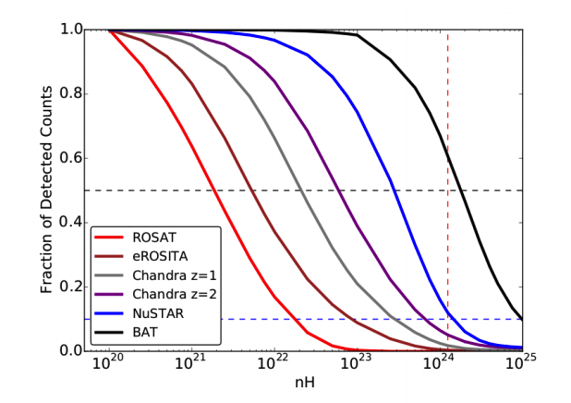
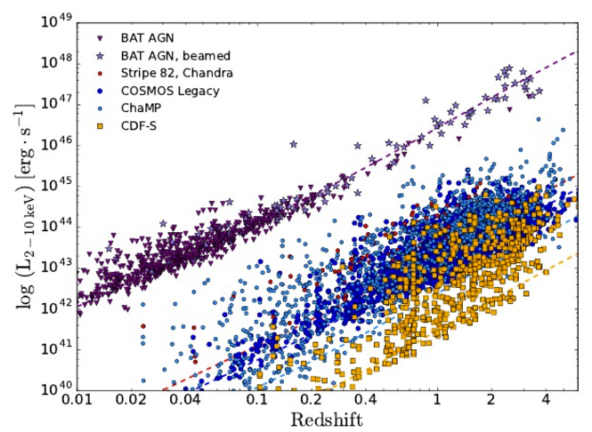
Hard X-ray selection – an unbiased, local sample!
Fraction of detected counts
L₂₋₁₀ _{keV} (ergs/s)
N_{H}
z
Koss et al. (submitted)
Notes:
These plots shows that Swift-BAT AGN are the best sample to use for this measurement. The plot on the left shows the ability of surveys to detect obscured AGN, where Y-axis shows reduction of count rates of different blind surveys vs. column density. Swift-bat is ideal, (shown with the black line) No other hard x-ray satellite has covered more area at its sensitivity.
The right plot shows the redshift vs. x-ray luminosity for the swfit-bAT sample (shown in purple) compared to some other x-ray surveys. It forms the largest, least biased sample of local AGN to date
add S82X Lx vs z

Slide 7
BAT AGN Spectroscopic Survey
Koss et al. (submitted)
Notes:
It’s all-sky, which reduces errors of clustering measurements due to cosmic variance, which is a problem for other x-ray pencil beam surveys, and spectroscopic redshifts have been acquired for all sources as part of the Swfit BAT AGN spectroscopic survey
We selected AGN in the redshift range .01 <z <.1, making a total of 409 total AGN. To boost statistics, we can cross-correlate with a larger galaxy sample, that also traces the underlying dark matter distribution.

Slide 8
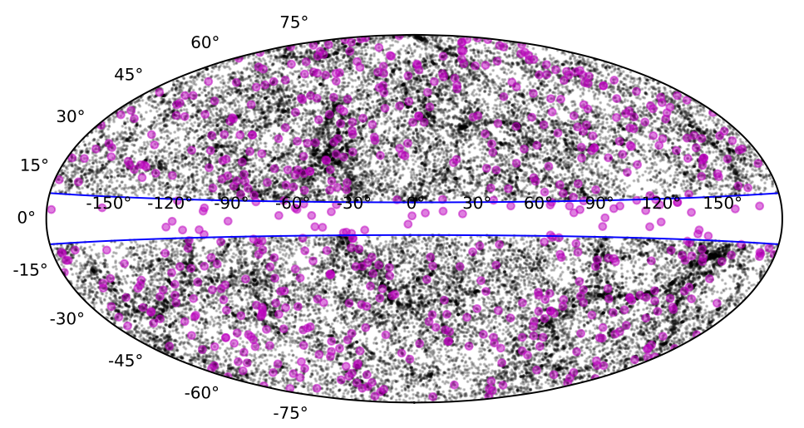
Cross-Correlate with 2MASS Galaxies
2MRS: Huchra et al. 2011
Notes:
For this case, we use 2MASS galaxies as a tracer sample, because they are essentially all-sky, and have about the same median redshift as the agn. The 2nass galaxies are shown in black here (~40,000) , the AGN in magenta.

Slide 9
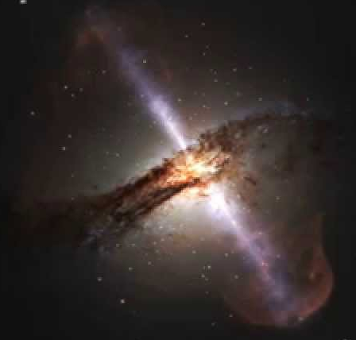
w_{p}(r_{p}) = w_{1-halo}(r_{p}) +w_{2-halo}(r_{p})
W_{p}
r_{p} (Mpc h⁻¹)
Scale (Mpc h⁻¹)
Notes:
The quantitative measure of clustering is the 2-pt correlation function, which measures the excess probability that a pair of objects is a given distance from each other, over a random distribution.
There are two terms in the correlation function that are dominant on different scales

Slide 10
w_{p}(r_{p}) = w_{1-halo}(r_{p}) +w_{2-halo}(r_{p})
2-halo term:
Mass of average DM halo
W_{p}
r_{p} (Mpc h⁻¹)
Scale (Mpc h⁻¹)
Notes:
On large scales, the so-called 2-halo term dominates, which measures the clustering of AGN in individual halos. From this you can estimate the average mass of the dark matter halos that the AGN reside

Slide 11
w_{p}(r_{p}) = w_{1-halo}(r_{p}) +w_{2-halo}(r_{p})
1-halo term:
AGN halo occupation distribution
Scale (Mpc h⁻¹)
Notes:
On smaller scales, the 1-halo term dominates, which measures the clustering of AGN in the same halo. This constrains the halo occupation distribution of AGN, which ill talk more about in a minute. This hasn’t been done much previoulsy, because need large samples or a large tracer set. but its powerful tool in interpreting the CF on both nonlinear and linear scales, and so we took advantage of it to model our measurement

Slide 12
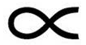
Halo Occupation Distribution (HOD)
avg # AGN in halo of mass M_{h}:
<N>(M_{h})
<N> = <N>_{cen} + <N>_{sat}
Self-consistent bias determination
(M_{h})^{α}
<N>_{sat}
<N>
<N>_{cen}
M_{min}
M_{h} (M)
Notes:
The halo occupation distribution is just the average number of objects in a halo as a function of halo mass. Its typically broken down into centrals and satellite components.
So for the AGN, we Modeled it as step function for central + plaw for satellite, for a 2-parameter model (minimum halo mass for a central, mmin, and alpha, the slope of the satellites)
Constraining this, you can recover all info from 2-halo term as well
The way we fit the correlation function with such a model is by comparing with mock samples. I did this by using halotools

Slide 13
Halotools (Hearin et al. 2016)
https://github.com/astropy/halotools
Notes:
Halotools is software developed by Andrew hearin, a postdoc at yale, for building and testing models of the galaxy-halo connection

Slide 14
Halotools (Hearin et al. 2016)
Obtains halo catalog from DM simulation
https://github.com/astropy/halotools
Notes:
Obtains a halo catalog from a DM simulation.

Slide 15
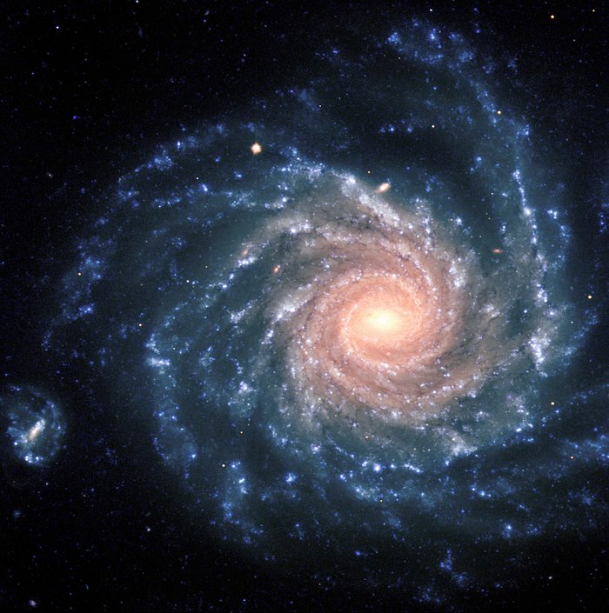
Halotools (Hearin et al. 2016)
Obtains halo catalog from DM simulation
Populates halo catalog with defined HOD
https://github.com/astropy/halotools
Notes:
It then populates the halo catalog with a defined halo occupation distribution, parametrized in any way

Slide 16
Halotools (Hearin et al. 2016)
Obtains halo catalog from DM simulation
Populates halo catalog with defined HOD
Computes 2-pt. statistics (w_{p GG}, etc.)
https://github.com/astropy/halotools
Notes:
It then can compute the clustering statistics
Benefit of using mocks rather than fitting analytically is that we can easily correct for incompleteness in the full flux-limited galaxy sample. The galaxy HOD has been well-calibrated, so we made a galaxy mock with this HOD and corrected for incompleteness as a function of luminosity to mimic our sample of 2mass galaxies. We then cross-correlated this mock sample with the AGN mock parametrized by our HOD model, to fit the cross-correlation function

Slide 17
AGN-Galaxy cross-correlation
W_{p}
r_{p} (Mpc h⁻¹)
L_{bol}~10^{44.7} ergs/s
Notes:
This plot shows our results of the cross-correlation measurement between the Swift-bat AGN and 2MASS galaxies.. the model of our best fit HOD is shown in green, and the the data/model is shown in the bottom panel. This is for our full sample, which has an average bolometric luminosity of 10^44.7, and average redhsit of ~.04
1&2 halo

Slide 18
Halo Occupation Distribution
<M_{h}> ~ 10^{12.8} M
<M_{h}>
Δχ²
alpha
<N>
Log M_{min} (M)
M_{h} (M)
Notes:
The left-hand plot shows the delta chi2 contours of the fit. Again, the 2 parameters of our HOD model was the mimimum halo mass to host an AGN and alpha, the powerlaw slope of the satellites. The right-hand plot shows the corresponding best-fit HOD (in black) with the bounds of from the 1 sigma confidence region
We find that as a result, the average halo mass for our sample is ~ 10^12.8 .

Slide 19
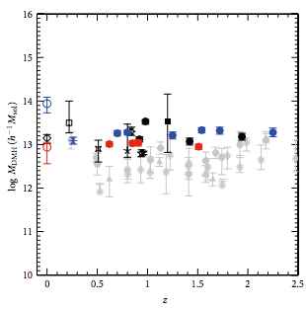
Halo Occupation Distribution
<M_{h}> ~ 10^{12.8} M
0 < α_{AGN} < 1
α<1 → AGN fraction decreases with M_{h}
α>0 → Not all AGN are centrals
clusters
Log M_{h} (Mh⁻¹)
groups
z
field
z
Notes:
To put this in context, this is consistent with other studies, and implies that they tend to live in galaxy groups
We also constrain 0<alpha <1. for galaxies;: alpha =1, where the number of galaxies per halo scales with Mh. So for an agn alpha <1 would mean that the AGN fraction decreases with halo mass above Mmin, possibly meaning that AGN avoid richest clusters
Also, while some studies have claimed AGN tend to be centrals, the fact that alpha >0 suggests there’s a significant satellite component

Slide 20
w_{p} vs. obscuration
N_{H} > 10²²
N_{H} < 10²²
Δχ²
W_{p}
alpha
r_{p} (Mpc h⁻¹)
Log M_{min} (M)
Matched L_{bol}
Notes:
Next, we split the sample in two bins of obscuration. To avoid incompleteness biases, we chose samples whose bolometric luminosity distributions matched. This is the result of the correlation function measurement and HOD fits, where red corresponds to obscured AGN and blue corresponds to unobscured. While the two-halo term looks similar between the two samples, obscured AGN seem more clustered on small scales. This corresponds to the differing HOD fits shown on the right.
To see whats driving the differences between the two types

Slide 21
Type 1 vs. Type 2
matched
Selection Effect?
no
L_{bol} (ergs/s)
z
Notes:
I plot the luminosity and redhsift distributions, showing that its probably not a selection effect
Another possible cause of the difference is from different host galaxy properites, as galaxy clustering is highly dependent on stellar mass, color, SFR, etc. only a fraction of the sources have the photometry available for obtaining these estimates, but for the fraction that do

Slide 22
Type 1 vs. Type 2
matched
Selection Effect?
no
L_{bol} (ergs/s)
z
Host galaxy differences?
no
Log Stellar Mass (M)
G-R (mag)
Notes:
We found do differences in stellar mass and color for both samples. So at this point we’re still unsure what’s driving the different environmental differences between the two types of AGN

Slide 23
Average Halo Masses
Obscured: <M_{h}> = 10^{12.9±0.2} M
Unobscured:<M_{h}> = 10^{12.2±0.2} M
Log M_{h} (Mh⁻¹)
z
z
DiPompeo et al. 2017
z
Notes:
From our HOD constraints we estimated the average dark matter halo of each bin to be different, where we found obscured AGN tend to be in more massive halos. This is consistent with recent results using IR AGN at z=1, shown by the triangle points.
Also, the average halo mass of the unobscured AGN was actually more consistent with optical quasar samples than x-ray agn.

Slide 24
(Preliminary) Conclusions
Local x-ray AGN (L_{bol} ~ 10^{44.7} ergs/s) live in DM halos of mass M_{h}~10^{12.8} M
AGN fraction decreases with halo mass?
Obscured AGN tend to live in more dense environments than unobscured AGN
Next:
environment vs. black hole mass, accretion rate
High-z measurements with Stripe 82X
Notes:
In conclusion, local hard x-ray selected AGN tend to live in dm halos of mass 10^12.8, typical of galaxy groups
Our HOD constraints suggest that a significant fraction of AGN are satellites, and that the fraction of galaxies that are agn decreases with halo mass
Lastly we found that obscured AGN tend to live in more dense environemnts than unobscured AGN, and the avg halo masses are consistent with the other large-volume surveys
Next, I will look at the environments as a function of black hole mass and accretion rate, and also compare with high redshift using the Stripe 82 x-ray survey, and interpret the results in terms of black hole-galaxy coevolution models.

Slide 26
AGN Fraction
Galaxy HOD / AGN HOD
AGN Fraction
M_{h}
Notes:
From our HOD constraints we estimated the average dark matter halo of each bin to be different, where we found obscured AGN tend to be in more massive halos. This is consistent with recent results using IR AGN at z=1, shown by the triangle points.
Also, the average halo mass of the unobscured AGN was actually more consistent with optical quasar samples than x-ray agn,

Slide 27

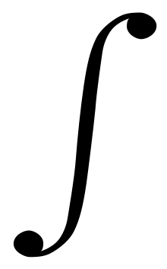
2-pt Correlation function
dP = n² [ 1 + ξ(r) ] dV₁ dV₂
Estimator:
ξ(r) = (DD-2DR+RR)/RR
DD: # data pairs
RR: # random pairs
DR: # data-random pairs
w_{p}(r_{p}) = 2 ξ(r_{p},π) dπ
r
dV₁
dV₂
z
Notes:
The quantitative measure of clustering is the 2-pt correlation function, which measures the excess probability that a pair of objects is a given distances from each other. We project in redshift to eliminate any redhisft space distortions to measure the projected 2-pt correlation function

